Slide 1
Chapter 4 The demand for labor in the short run

Slide 2
The marginal productivity theory of Labor
To develop the neoclassical marginal productivity model, several simplifying assumptions must be made:
First: the goal of business firms is to maximize dollar profits.
Second: in order to simplify the graphic analysis, it is assumed that the firm uses only two factors of production, capital and labor, to produce its product.
Third: The business firm operates in perfectly competitive product and labor markets.
Finally: wages represent the only cost of labor and that labor is completely homogeneous, meaning that each worker is identical.

Slide 3
The marginal productivity theory of Labor
Q. How many workers should a business firm hire?
As long as additional workers bring in more revenue than the cost of hiring them, the firm adds of its profit by increasing employment; when the last worker added by the firm brings in revenue no greater than the labor cost, hiring should stop and profits will be at a maximum.`

Slide 4
The marginal productivity theory of Labor
Production Function: Q = f (K, L)
Since the amount of capital is fixed in the short run, additional output can be produced by the firm only hiring additional workers. Holding capital constant, production function implies the increase in output that would result from these extra workers.
Marginal Product of Labor:
MPL= ∆Q / ∆L
That is- the marginal product of labor is defined as the increase in total production (∆Q) from adding one more unit of labor (∆L)

Slide 5
The marginal productivity theory of Labor
Law of Diminishing Return:
It states that, holding one factor of production constant, adding additional units of another factor will increase production, but eventually only at a diminishing rate.
Average product of Labor: APL = Q/L
The average amount of output produced per worker.
As long as the MP is greater than the AP, the latter continues to rise, and when the MP is less than AP the latter falls.

Slide 6
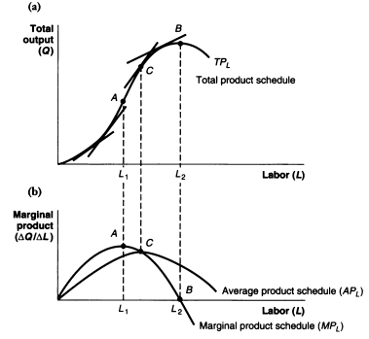
The marginal productivity theory of Labor

Slide 7
The marginal productivity theory of Labor
Marginal Revenue Product of Labor:
MRPL= MR. MPL
MRPL express the marginal benefit to the firm from hiring additional workers. The decision rule to maximize profits is to continue to hire workers as long as the marginal benefit exceeds the marginal cost.
Marginal Cost of Labor:
The cost per hour to the firm of hiring each worker is equal to the wage rate. That is-
MC= W

Slide 8
The marginal productivity theory of Labor
Equilibrium Level of Employment:
At equilibrium,
Marginal Cost = Marginal Benefit
=> W = MRPL
=> W = MR. MPL
For a competitive firm, P = MR
Therefore, W = P. MPL
=> W/P = MPL => w = MPL

Slide 9
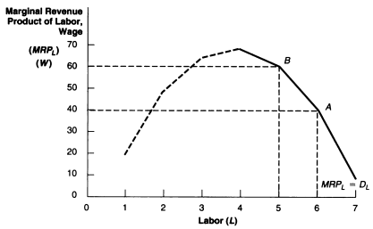
A Hypothetical MRPL Schedule and Labor Demand Curve

Slide 10
A Hypothetical MRPL Schedule and Labor Demand Curve
To hire each additional worker as long as the increase in MRPL is greater than or equal to the increase in Wage cost.
Q. At a wage rate of $40 per hour, how many workers have a MRPL greater or equal to that wage?
Q. What would happen to the firm’s demand for labor if the wage rate are to increase from $40 to $60 per hour?

Slide 11
Labor Demand Curve
For demand curve for labor, consider the following:
First, a change in the wage rate causes a movement along one particular demand curve.
Second, a change in the firm demand curve for labor for the following reasons will shift in the demand curve:
A change in product demand
Imperfect competition in the product market.

Slide 12
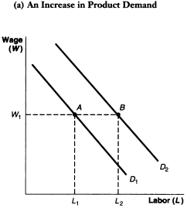
A change in product demand

Slide 13
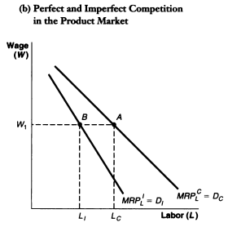
Imperfect competition in the product market.

Slide 14
Imperfect competition in the product market
The diagram shows that the labor demand curve for an imperfectly competitive firm DI will lie to the left and be steeper than the demand curve for a competitive firm DC.
At the prevailing wage of W, the imperfectly competitive firm will hire fewer workers (LI) than the competitive firm (LC). It will also expand employment by a smaller amount than would a perfectly competitive firm in response to a decrease in the wage.

Slide 15
Imperfect competition in the product market
The labor demand curve for an imperfectly competitive firm will lie to the left and be steeper than the demand curve for a competitive firm.
The reasons behind that—
First: Because the MPL for each worker declines due to diminishing return in production, as for the competitive firm.
Second: Because its marginal revenue for extra production also declines, unlike that of the competitive firm.

Slide 16
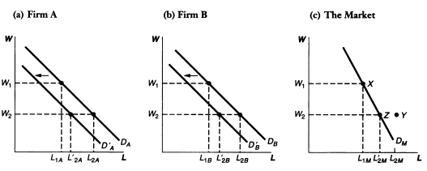
Derivation of the Market Labor Demand Curve

Slide 17
The Elasticity of Demand for Labor
The elasticity of labor demand shows that how sensitive employment is to changes in the cost of labor (i.e. wage rate). It is defined as—
ED= (%∆L) / (%∆W)
Where,
%∆L = Percentage change in Employment
%∆W= Percentage change in wage rate.
The following five types of elasticity of labor demand are:
When ED= 0, perfectly inelastic labor demand.
If 10% increase in the wage rate causes no change in the demand for labor.

Slide 18
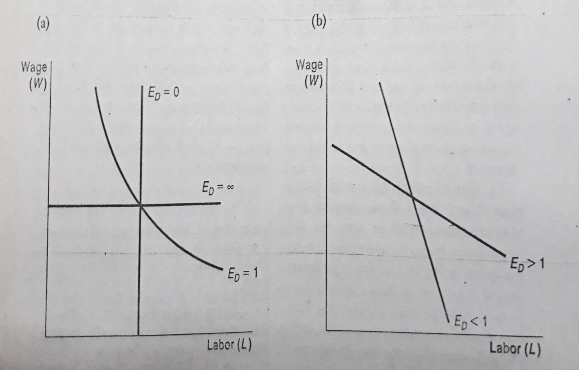
The Elasticity of Demand for Labor

Slide 19
The Elasticity of Demand for Labor
When ED< 1, inelastic labor demand. If a 10% increase in the wage rate led to only a 5% reduction in the demand for labor.
When ED= 1, unit elastic labor demand. If a 10% increase in the wage rate causes a 10% reduction in the demand for labor.
When ED > 1, elastic labor demand. If a 10% increase in the wage rate led to more than 10% reduction in the demand for labor.
When ED = ∞, perfectly elastic labor demand. If the firm is willing to hire all the additional employees it can at the prevailing wage, but will hire no employee at any higher wage.

Slide 20
The Wage Bill
The wage bill is defined as the firm’s total money outlay for labor. It is calculated by multiplying the average wage rate per hour (W) times the total number of worker employed (L). That is—
Wage Bill = W. L
If the labor demand is inelastic, a rise in wage rate will result in a net increase in the total wage bill, since the percentage increase in the wage W will exceed the percentage decline in employment, L, making the product (W.L) greater than before.
If the labor demand is elastic, a rise in wage rate will result in a net decline in the total wage bill, since the percentage decrease in employment will be greater than the percentage increase in W, making the product (W.L) smaller than before.

Slide 21
Wage Subsidy Programs
Even in the best of times a significant number of persons face great difficulty finding employment, persons sometimes identified as the structural or hard-core unemployed. Prominent among the hard-core unemployed are people in three problems groups:
Low-skilled adults
Disadvantaged youth, and
Residents of economically depressed areas.
Q. Why cannot the hard-core unemployed find work?
One ordinary answer is—
A combination of discrimination and a shortage of jobs in the economy.

Slide 22
Wage Subsidy Programs
Q. Why cannot the hard-core unemployed find work?
One ordinary answer is—
A combination of discrimination and a shortage of jobs in the economy.
However, the most acceptable answer is—
Applying the marginal productivity theory of labor, the firms simply do not find it profitable to hire these people. Because—
These workers have a very low level of productivity. The main reason is that many disadvantaged youths are high school dropout who have neither the basic educational skills nor the good work habits that are necessary in today’s job market.

Slide 23
Wage Subsidy Programs
The minimum wage law prevents employers from lowering their rate of pay enough to make it profitable to hire the hard-core employed.
From the perspective of MPT, the policymakers have suggested two alternative solutions to attack the problems:
Manpower training programs that provide the hard-to-employ with specific job skills. And
To lower the cost to the firm of hiring the hard-core unemployed.

Slide 24
The Effect of A Wage Subsidy Program on Labor Demand
The wage subsidy program aims to create additional jobs in the economy by subsidizing the employ’s cost of labor. Unlike public-service-type programs that create new jobs through expanded government employment, wage subsidy programs focus on employment in the private sector.
In designing a wage subsidy program, policy makers can choose the following alternatives:
First, the program is “categorical” in that the wage subsidy applies only to workers of some identifiable low-skill group, such as teenagers or welfare recipients.
Second, the firm receives a wage subsidy only for people newly hired, not for existing employees. This type is sometimes called ‘marginal’ or ‘incremental’ subsidy.

Slide 25
The Effect of A Wage Subsidy Program on Labor Demand
Third, applicable those new workers who earn a wage less than a target wage rate of Wt qualify for subsidy.
Fourth, for every worker hired the employer receives a subsidy payment per hour S equal to some percent r of the difference between the target wage, Wt and the pre-subsidy wage, Wp. The subsidy payment is given by the formula:
S= r (Wt - Wp)
The subsidy payment received by the firm will be greater for higher values of the subsidy rate r or the greater the difference between Wt and Wp.

Slide 26
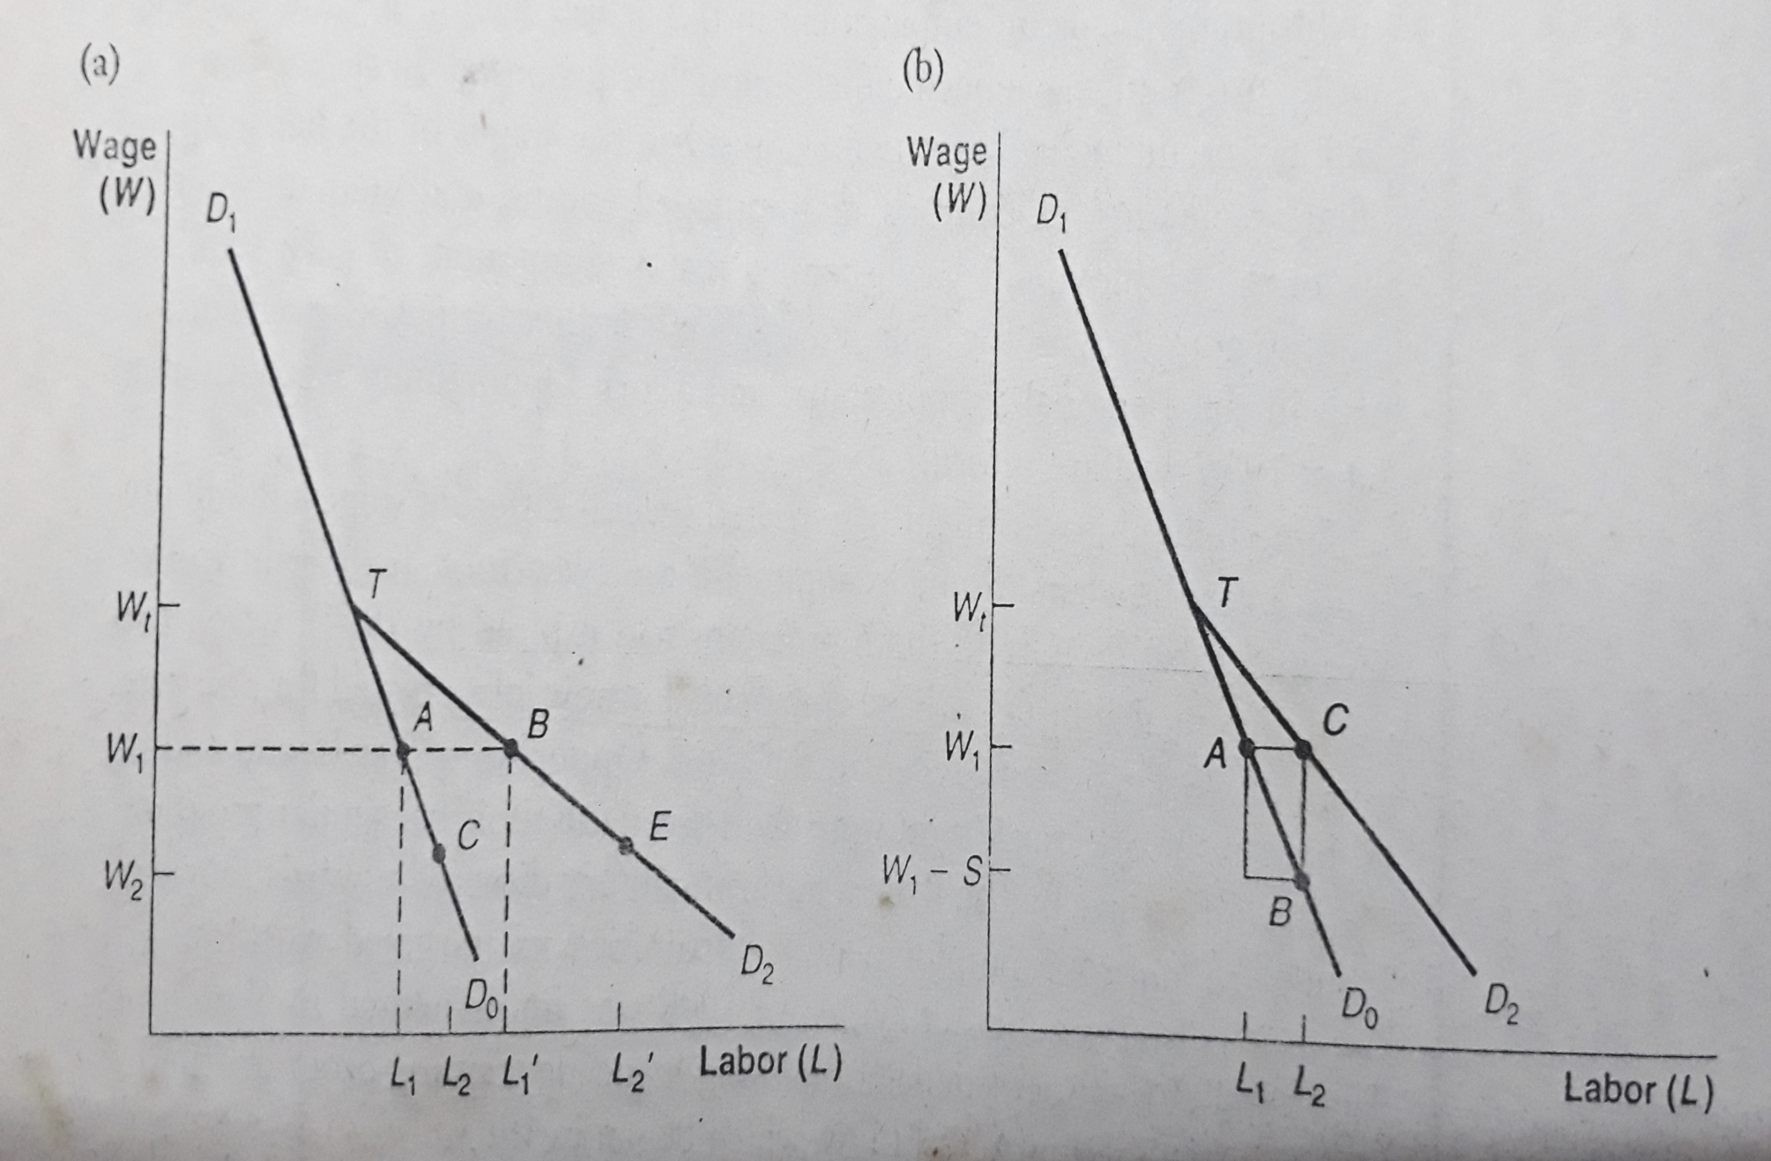
The Effect of A Wage Subsidy Program on Labor Demand

Slide 27
The Effect of A Wage Subsidy Program on Labor Demand
Q. What are the positive and negative aspect of wage subsidy program?
Advantages:
Stimulates employment for those workers who are the lowest paid or most marginal in the labor market.
Subsidy payment is reduced as the worker’s wage increases with experience and training, gradually weaning the worker from the program.

Slide 28
The Effect of A Wage Subsidy Program on Labor Demand
Q. What are the positive and negative aspect of wage subsidy program?
Disadvantages:
Encourage employers to replace full-time workers with part-time workers.
The employers may churn their labor force by replacing experienced, higher-wage employees with inexperienced, low-wage workers from the target group in order to maximize the amount of subsidy per worker.
It may reduce employment prospects for the very group of people it is meant to help.

Slide 29
The Effect of Import Restrictions on Auto Employment
The marginal productivity theory of labor demand can be used to illustrate the effect of import restriction on auto workers.
Reducing competition in any market drives up the price. When the price for a final product is higher, the marginal revenue product of labor in that industry is higher, leading to higher level of employment. The restriction might take in the form of either tariff or quota.
This simple model predicts that import restrictions would lead higher output, higher prices, and higher employment in the domestic industry.

Slide 30
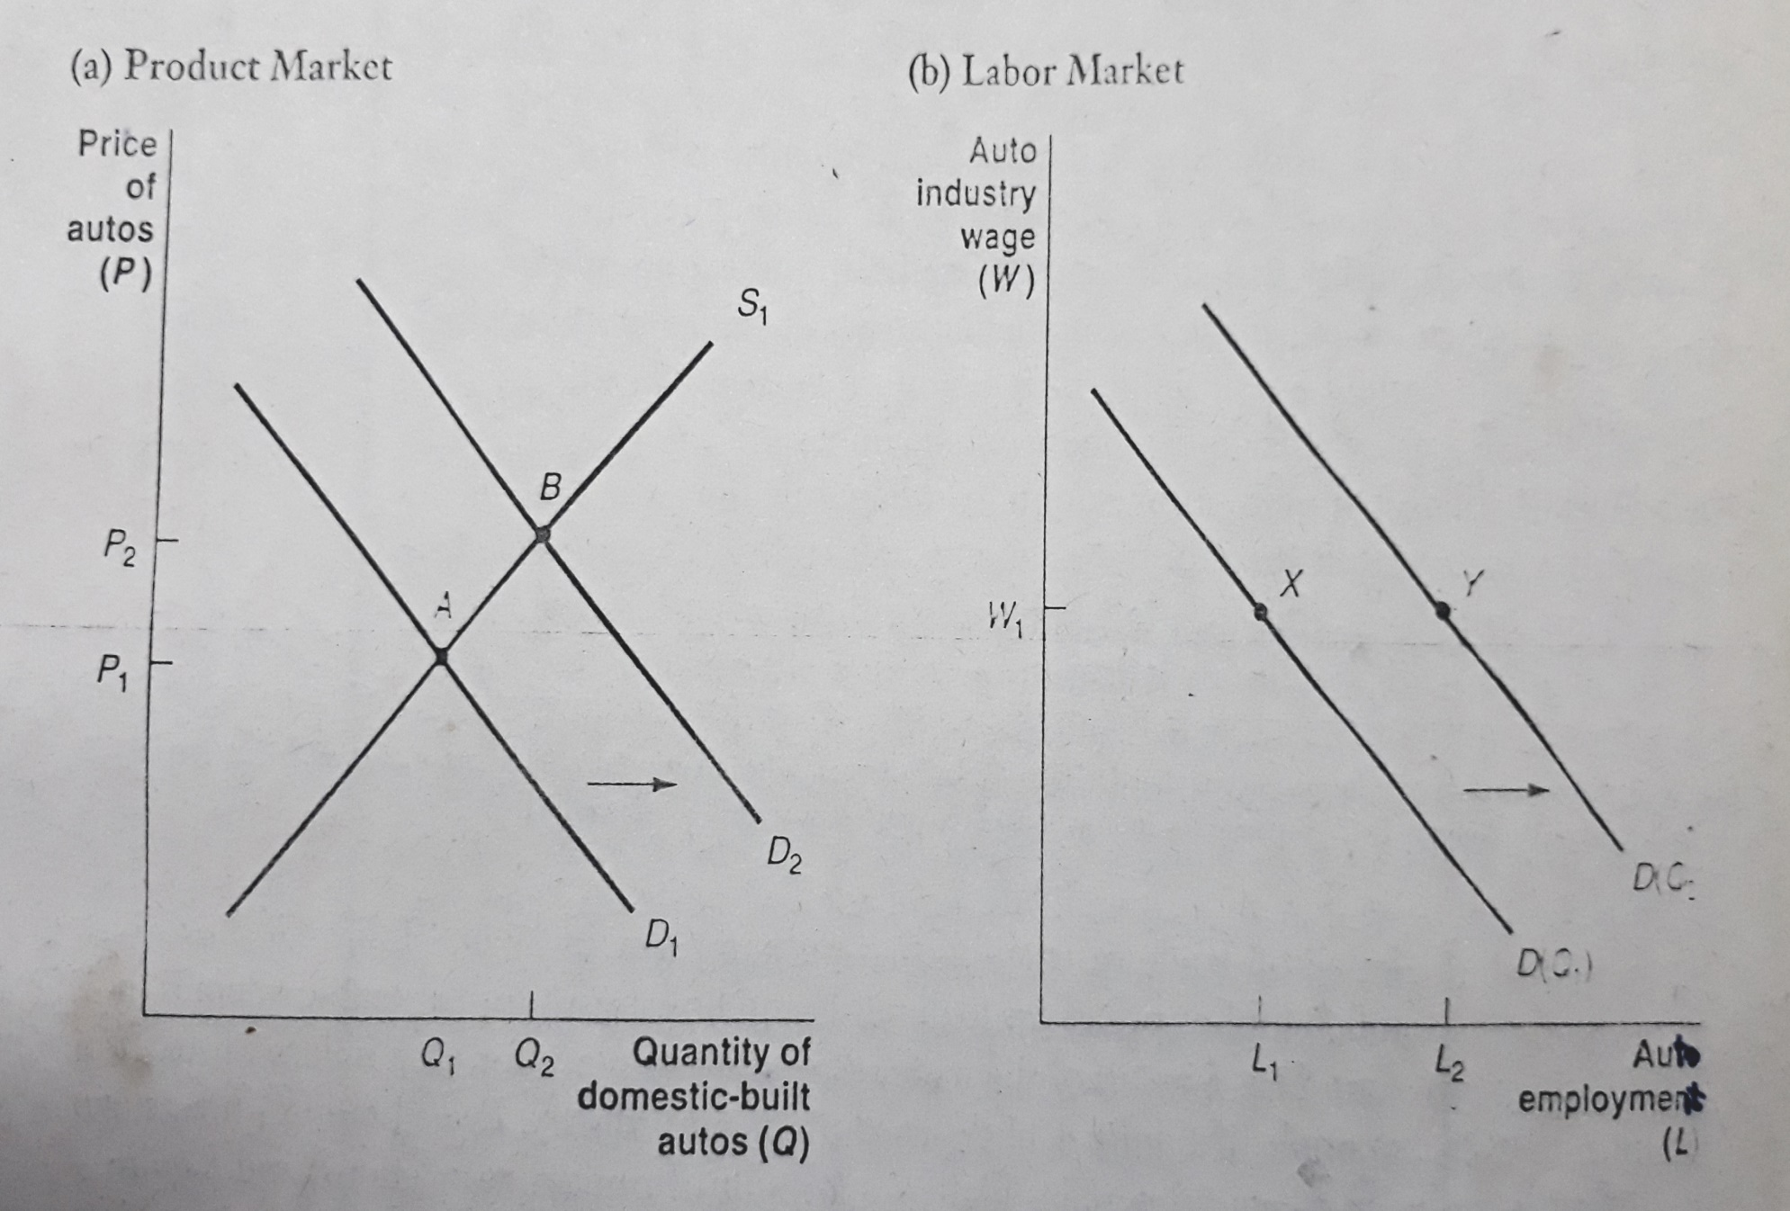
The Effect of Import Restrictions on Auto Employment

Slide 31
The Demand for Labor and Union Wage Concessions
Empirical evidence reflects that the unions are more likely to agree to wage concessions when the demand for their labor becomes more elastic and when they face a decrease in overall demand for their labor.
The reason implies that when labor demand becomes more elastic, a wage increase of a certain percentage will be accompanied by a decrease in employment by an even larger percentage than originally projected.

Slide 32
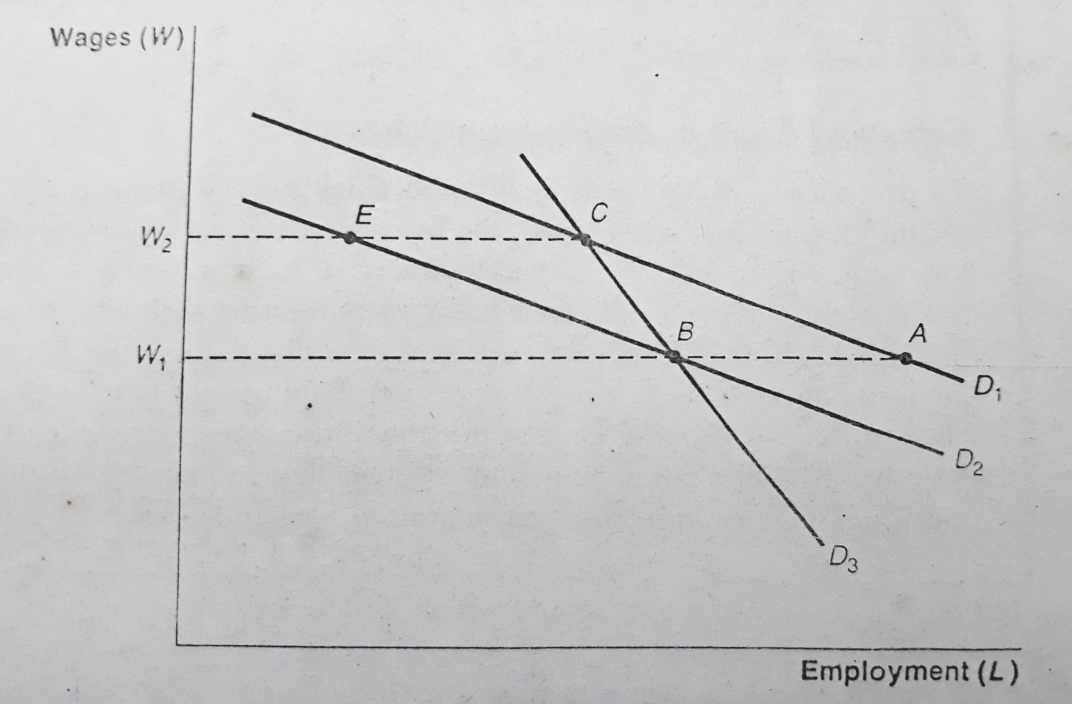
The Demand for Labor and Union Wage Concessions

